Slide 1
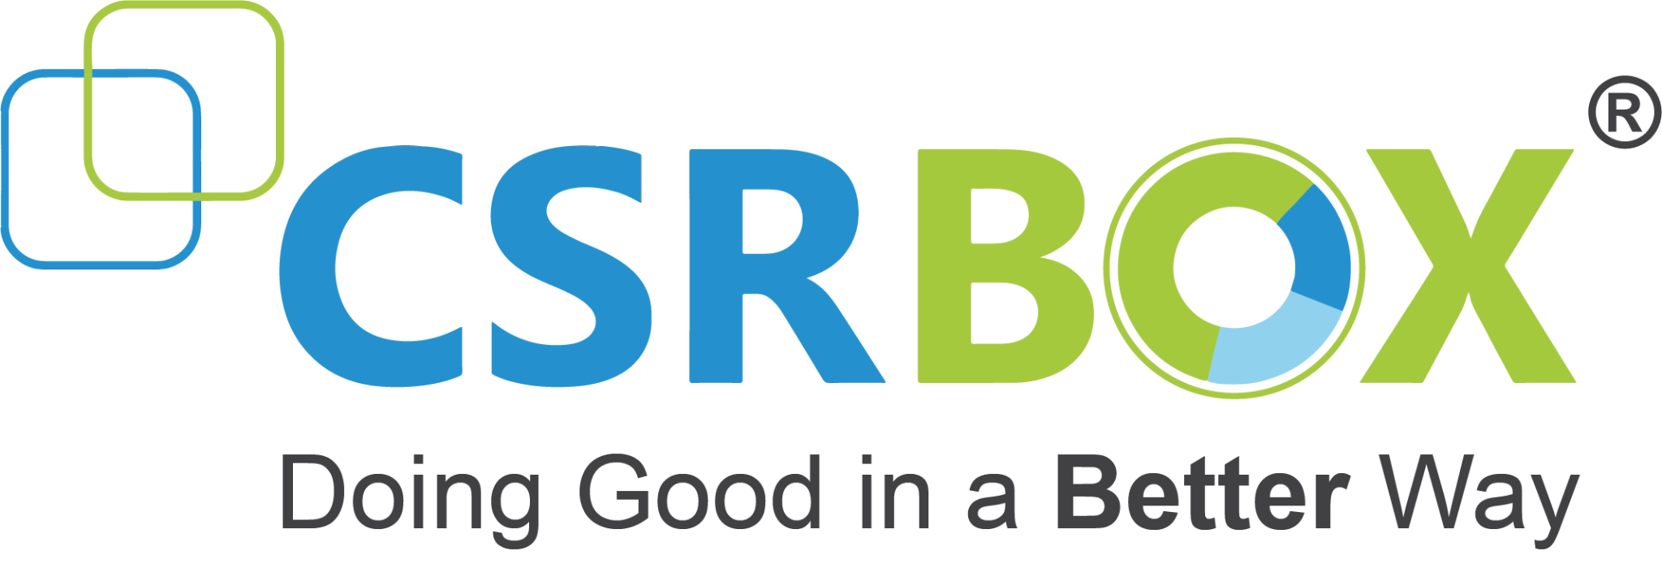
IBM SkillsBuild for Adult Learners - Data Analytics
Data Analytics Internship Program 2024 Final Project Presentation
Project Name : SDG:-6 Clean Water and Sanitation
Unique ID: IBM2852 Team Name: Insightful Analysts
College Name: MIT ADT UNIVERSITY

Slide 2
Team Members
Vaishanvi Sagar Taware
Tejaswini Sandeep Bhujbal
Shruti Yashwant Gaikwad
Sankalp Pravin Dhembare

Slide 3
Introduction
Overview of the Project :-
Data Analysis:
Utilizing datasets (Clean1 to Clean7) to examine trends and disparities in access to clean water and sanitation.
Focus on urbanization levels (National, Rural, Urban) from 2016 to 2022.
Key metrics include the percentage of the population using safely managed drinking water services.
Key Insights:
National Level: Generally high access, with stable percentages around 87%-89%.
Rural Level: Lower access, with percentages around 80%-81%.
Urban Level: Highest access, with stable percentages at 94%-95%.
Highlighting the disparity between urban and rural areas.
Visualization:
Creation of heatmaps and line graphs to visually represent the data trends and disparities.
Example heatmap shows access percentages by year and urbanization level, indicating higher access in urban areas.
Goals:
Identify regions with the greatest need for improvement.
Provide data-driven recommendations to policymakers and stakeholders.
Support initiatives to enhance water and sanitation services, particularly in rural areas.

Slide 4
Objective :-
The project aims to analyze and improve the access to safely managed drinking water and sanitation services in Pacific Island Countries and territories, in alignment with United Nations Sustainable Development Goal 6 (SDG 6).

Slide 5
Problem Identification
Problem Statement :- Despite global efforts to achieve United Nations Sustainable Development Goal 6 (SDG 6) — ensuring availability and sustainable management of water and sanitation for all — significant disparities persist in access to safely managed drinking water services across Pacific Island Countries and territories.
Significance of the Problem:-
Health and Well-being:
Increased Disease Risk: Limited access to clean water and sanitation is directly linked to the prevalence of waterborne diseases such as cholera, diarrhea, and dysentery.
Child Mortality: Children in areas with poor water and sanitation services are at higher risk of death due to preventable diseases.
Economic Impact:
Healthcare Costs: Higher incidence of water-related illnesses leads to increased healthcare costs for both individuals and governments.
Productivity Loss: Poor health due to inadequate water and sanitation can result in decreased productivity and economic output.

Slide 6
Problem Identification
Problem Statement :- Despite global efforts to achieve United Nations Sustainable Development Goal 6 (SDG 6) — ensuring availability and sustainable management of water and sanitation for all — significant disparities persist in access to safely managed drinking water services across Pacific Island Countries and territories.
Significance of the Problem:-
Health and Well-being:
Increased Disease Risk: Limited access to clean water and sanitation is directly linked to the prevalence of waterborne diseases such as cholera, diarrhea, and dysentery.
Child Mortality: Children in areas with poor water and sanitation services are at higher risk of death due to preventable diseases.
Economic Impact:
Healthcare Costs: Higher incidence of water-related illnesses leads to increased healthcare costs for both individuals and governments.
Productivity Loss: Poor health due to inadequate water and sanitation can result in decreased productivity and economic output.

Slide 7
Problem Identification
Relevant Sustainable Development Goals (SDGs):-
SDG 6: Clean Water and Sanitation
Goal: Ensure availability and sustainable management of water and sanitation for all.
Target 6.1: By 2030, achieve universal and equitable access to safe and affordable drinking water for all.
Target 6.2: By 2030, achieve access to adequate and equitable sanitation and hygiene for all and end open defecation.
SDG 3: Good Health and Well-being
Goal: Ensure healthy lives and promote well-being for all at all ages.
Target 3.3: By 2030, end epidemics of AIDS, tuberculosis, malaria, and neglected tropical diseases and combat hepatitis, water-borne diseases, and other communicable diseases.
Target 3.9: By 2030, substantially reduce the number of deaths and illnesses from hazardous chemicals and air, water, and soil pollution and contamination.

Slide 8
Data Collection
Sources of Data :- https://pacificdata.org
Data Description:-
Datasets
Clean1.csv to Clean7.csv: Each dataset contains annual data on water and sanitation metrics for different regions within the Pacific Island Countries.
Key Variables
Year:
Description: The year in which the data was recorded.
Range: 2016 to 2022.
Type: Integer.
Country/Region:
Description: The specific Pacific Island country or territory being analyzed.
Examples: Fiji, New Caledonia, Papua New Guinea, Solomon Islands, Vanuatu, Kiribati, Marshall Islands, Micronesia, Nauru, etc.
Type: String.
Urbanization Level:
Description: The classification of the population based on their location.
Categories: National, Rural, Urban.
Type: Categorical.
Percentage of Population Using Safely Managed Drinking Water Services:
Description: The percentage of the population with access to safely managed drinking water services.
Range: Varies by country and urbanization level, typically between 30% and 100%.
Type: Float.

Slide 9
Data Collection
Data Collection Method’s :-
Government Reports and Statistics:
National and regional governments of Pacific Island Countries collect and publish data on water and sanitation services.
Ministries of Health, Water Resources, and Environment typically oversee data collection and reporting.
International Organizations:
United Nations agencies (e.g., UNICEF, WHO) and other international bodies (e.g., World Bank) provide standardized data collection frameworks and support.
Data often aggregated and validated through international databases like the Joint Monitoring Programme (JMP) for Water Supply and Sanitation.

Slide 10
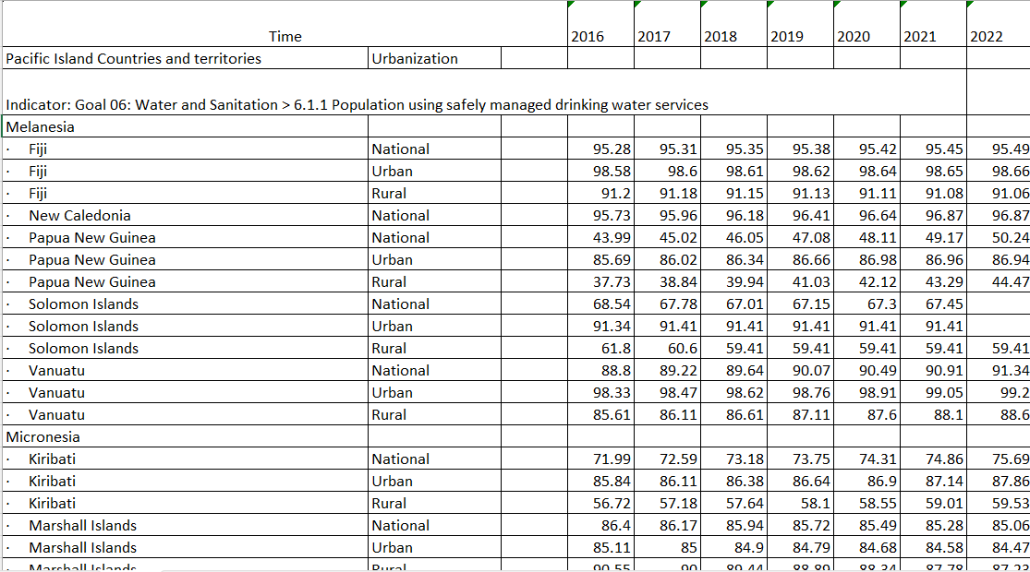
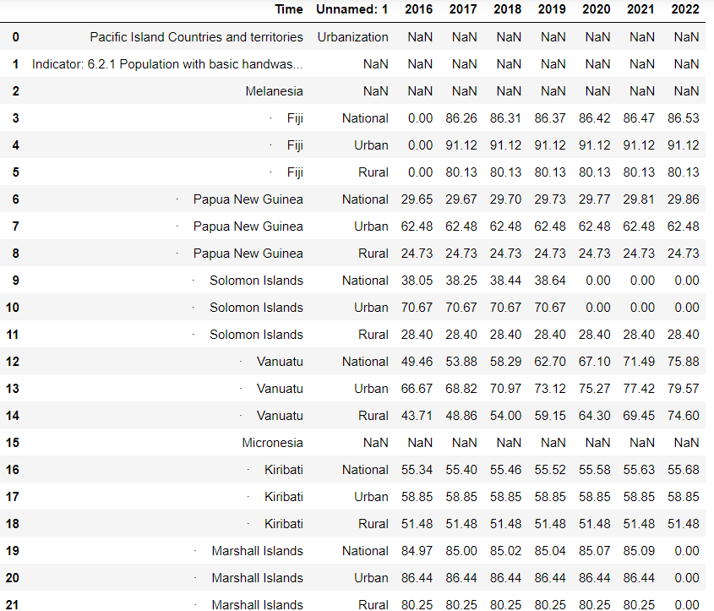
Snapshots of Data
Dataset in Excel
Dataset clean in the Jupyter Notebook

Slide 11
Data Preprocessing
Data Cleaning Methods
- Data Validation: Cross-referencing data from multiple sources to identify and correct errors.
- Outlier Detection: Identifying and handling outliers using statistical techniques to ensure data accuracy.
Handling Missing Values
- Imputation: Replacing missing values with mean, median, or mode of the respective feature.
- Deletion: Removing records with missing values if they constitute a small proportion of the dataset.
Data Transformation Techniques
- Normalization: Scaling data to a standard range (e.g., 0 to 1) to ensure uniformity.
- Encoding: Converting categorical variables into numerical formats using techniques like one-hot encoding.

Slide 12
Data Analysis
Analytical Tools and Methods Used
- Python and Pandas: For data manipulation, cleaning, and analysis.
- Matplotlib and Seaborn: For creating visualizations such as line graphs and heatmaps to represent data trends.
Key Findings
- Urban-Rural Disparities: Urban areas consistently show higher access to safely managed drinking water compared to rural areas.
- Progress Over Time: Gradual improvement in water access across most Pacific Island Countries from 2016 to 2022.
Insights Derived
- Policy Impact: Areas with focused governmental and international support show significant improvements in water access.
- Target Areas: Identified regions and populations where access to safely managed drinking water remains critically low, guiding future interventions.

Slide 13
Hypothesis Development
Formulated Hypothesis
- Hypothesis: Urban areas in Pacific Island Countries have significantly higher access to safely managed drinking water services compared to rural areas.
Rationale Behind the Hypothesis
- Observation: Preliminary data analysis indicates a noticeable disparity in water access between urban and rural regions.
- Global Trends: Similar patterns have been observed worldwide, where urban infrastructure tends to be better developed than rural counterparts.
Method for Testing the Hypothesis
1. Data Segmentation:
- Separate the dataset into urban and rural subsets for each country.
2. Statistical Analysis:
- Use t-tests to compare the mean percentages of safely managed drinking water access between urban and rural areas.
3. Visualization:
- Create line graphs and heatmaps to visually compare the trends and disparities in water access over time between urban and rural areas.

Slide 14
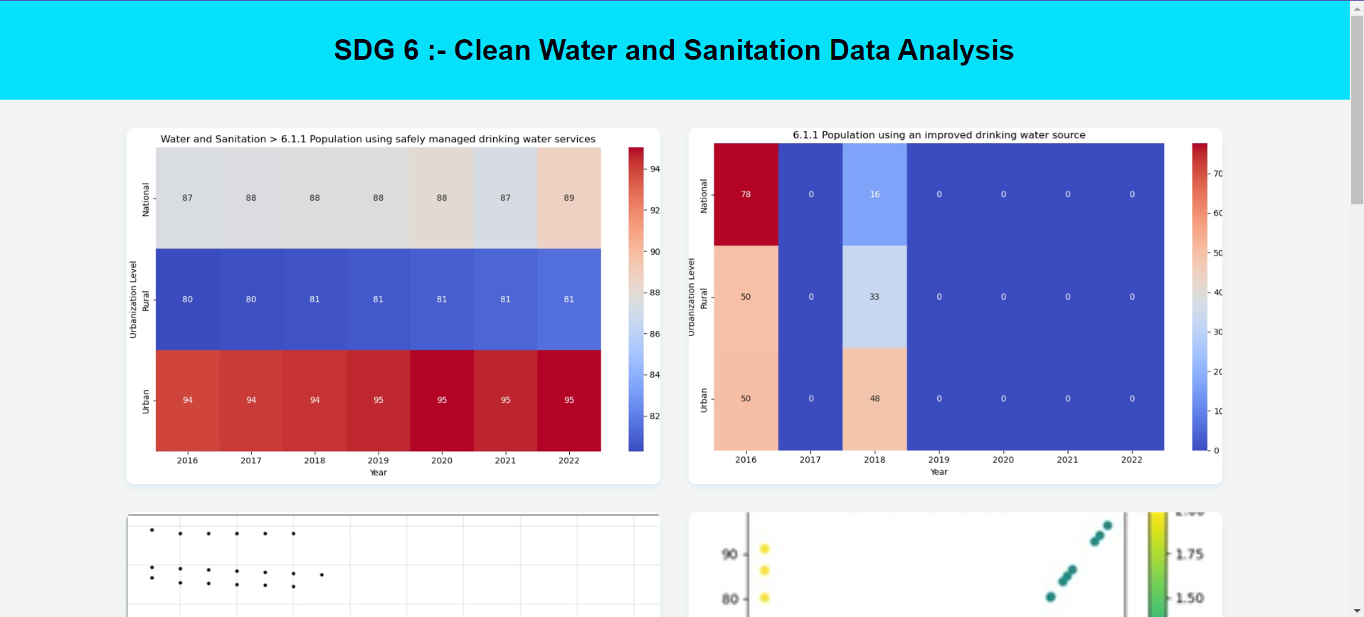
Dashboard Design

Slide 15
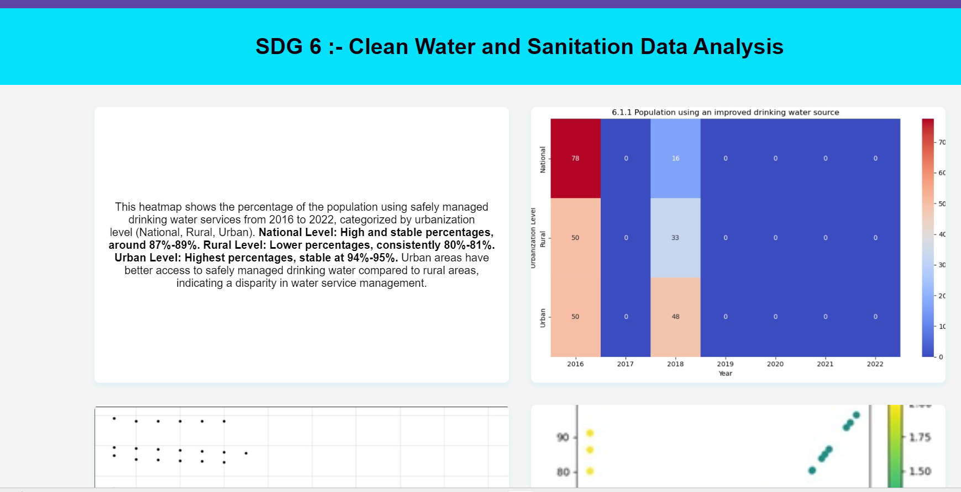
Dashboard Design

Slide 16
Visualization
Data Visualization Techniques Used
- Line Graphs: To display trends in access to safely managed drinking water services over time.
- Heatmaps: To illustrate the distribution and intensity of water access across different regions and urbanization levels.
Charts, Graphs, Maps, etc.
1. Line Graphs:
- Show the percentage of population with access to safely managed drinking water from 2016 to 2022 for urban, rural, and national levels.
2. Heatmaps:
- Highlight disparities in water access between different countries and urbanization levels.
3. Bar Charts:
- Compare water access percentages among different countries and urbanization levels for specific years.
4. Geospatial Maps:
- Visualize geographic disparities in water access across Pacific Island Countries.
Key Visual Insights
- Consistent Urban Advantage: Line graphs reveal a consistent trend of higher water access in urban areas compared to rural areas.
- National Progress: Heatmaps show overall improvements in national water access percentages over time, with noticeable disparities between countries.
- Critical Regions: Bar charts identify specific countries and regions with the lowest access to safely managed drinking water, highlighting areas needing urgent attention.

Slide 17
References
Conclusion
Data Sources
- Clean1.csv to Clean7.csv: Datasets containing various aspects of clean water, sanitation, and wastewater treatment across Pacific Island Countries and territories.
- Urbanization Data: Information on urbanization levels (rural, national, urban) for analysis.
Tools and Software Used
- Python: For data manipulation and analysis, using libraries like Pandas and NumPy.
- Matplotlib/Seaborn: For plotting line graphs and visualizations.
- Jupyter Notebook: For interactive coding and documentation.
- Excel: For initial data examination and manipulation if needed.
Additional References
- United Nations Sustainable Development Goals (SDGs): Particularly SDG 6: Clean Water and Sanitation.
- Relevant Literature: Articles or reports on wastewater treatment in Pacific Island countries, urbanization trends, and their impact on water resources.
- Data Documentation: Any metadata or documentation provided with the datasets for clarification on the data collection methods and definitions.

